Slide 2
Problem Description
What factors affect a country’s economy?
How significant of the impact for each of them?

Slide 3
GDP is commonly used to determine the economic performance or a nation. —— From Wikipedia
Factors
Relationship?
Subjective Governance Factors | Objective Statistical Factors
Control of Corruption | Arable land (hectares per person)
Government Effectiveness | Labor force participation rate, female
Political Stability | Labor force participation rate, male
Regulatory Quality | Life expectancy at birth, female (years)
Rule of Law | Life expectancy at birth, male (years)
Voice and Accountability | Population growth (annual %)
 | Population, total
 | Adolescent fertility rate
 | Proportion of female in national parliaments (%)
 | Urban population (% of total)
GDP per Capita

Slide 4
How important is this half to the economy?
Special factors considered:
Adolescent fertility rate (births per 1,000 women ages 15-19)
Proportion of seats held by women in national parliaments (%)

Slide 5
Data and Model
Data
200 countries, 10 years (2005 ~ 2014) --- 2000 data points
Regression
What’s the relationship between GDP per capita (dependent variable) and the 16 selected factors (Independent variables)?
Machine learning models applied:
Linear regression with Lasso (Lasso regression)
Support vector regression (SVR)
Regression tree
Conditional inference tree (Ctree)
Random forest
Conditional inference random forest (Cforest)
eXtreme gradient boosting (XGBoost)

Slide 6
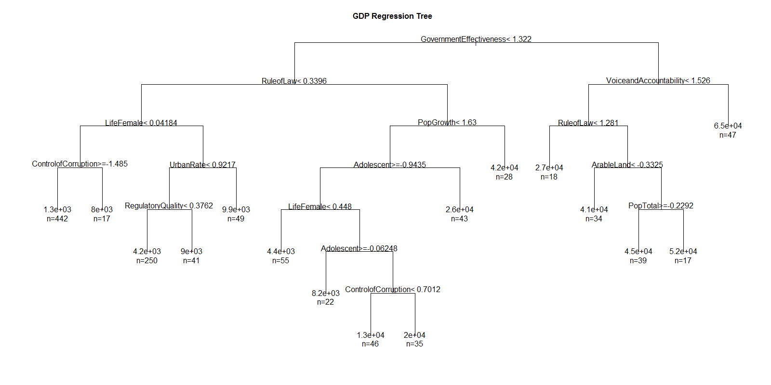
Model – Regression tree

Slide 7
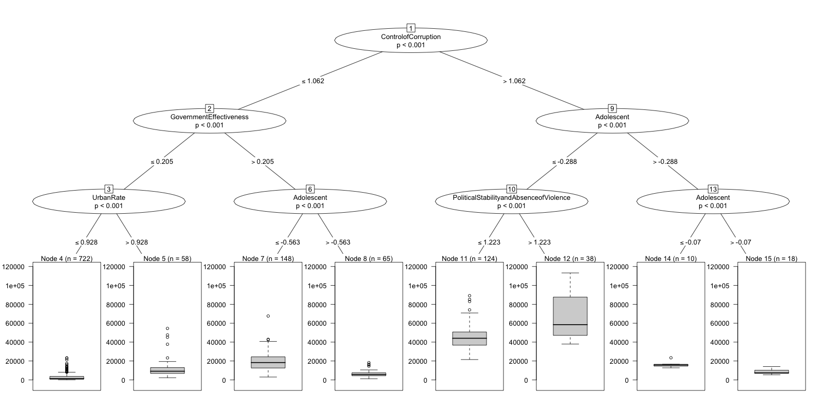
Model – Conditional inference tree

Slide 8
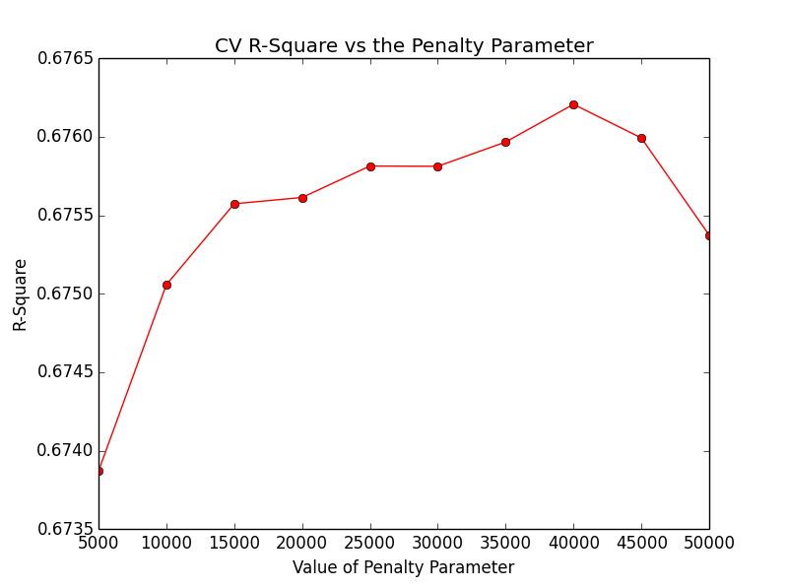
Model – cross validation for Support vector regression

Slide 9
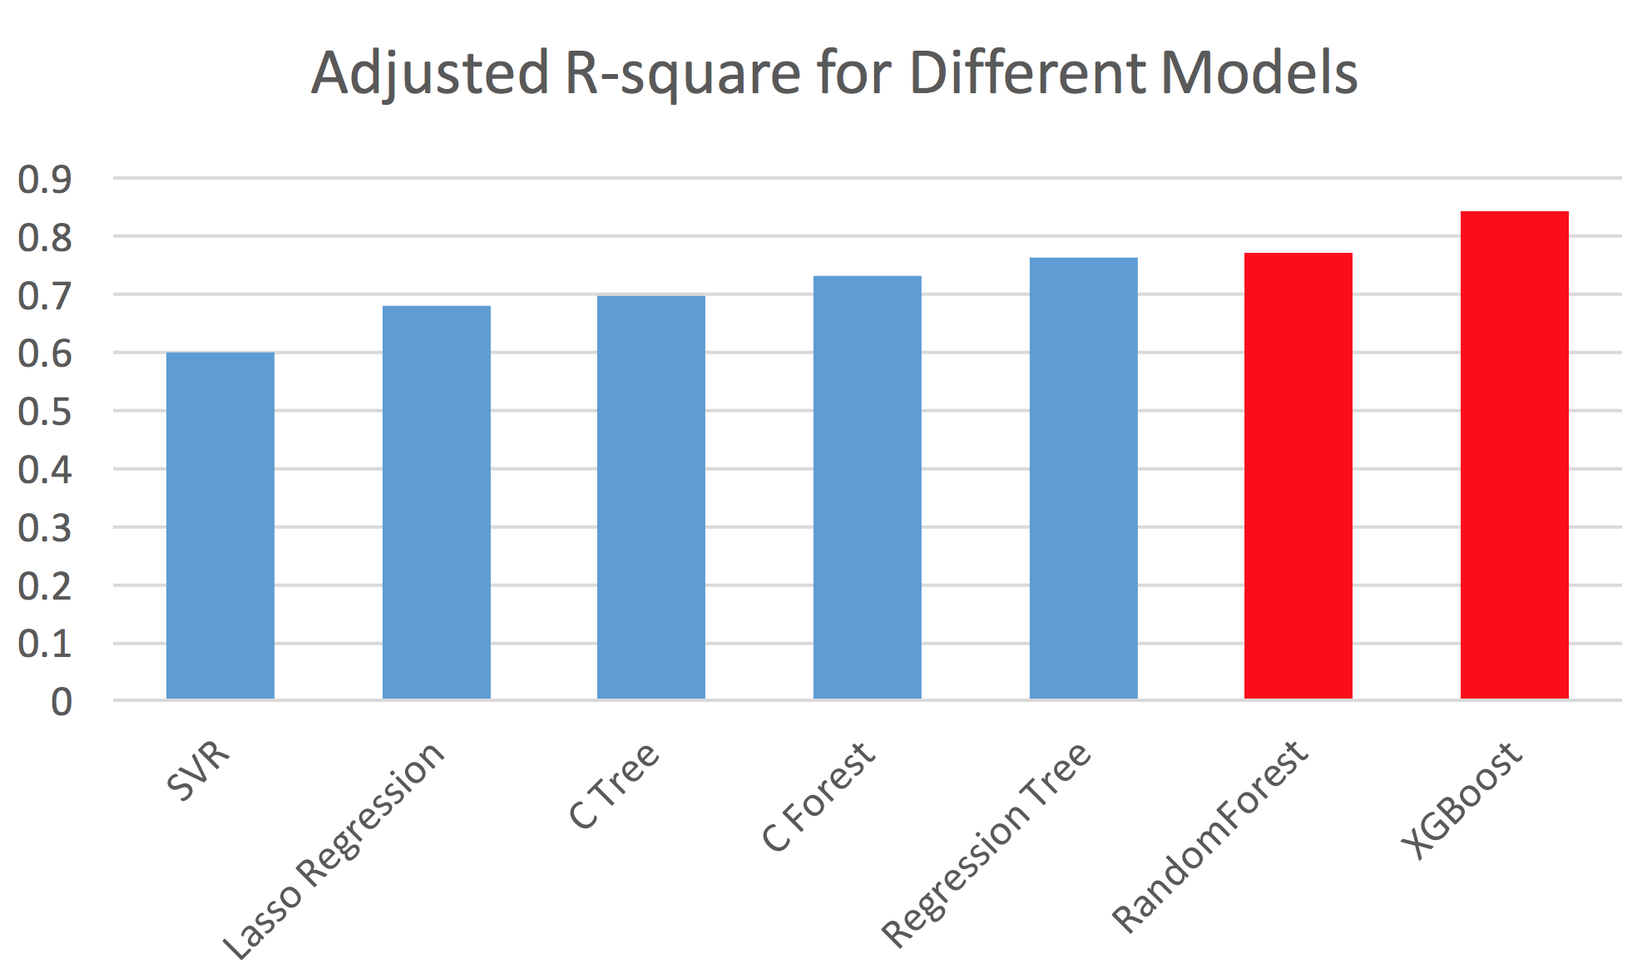
Model result – comparison of model accuracy

Slide 10
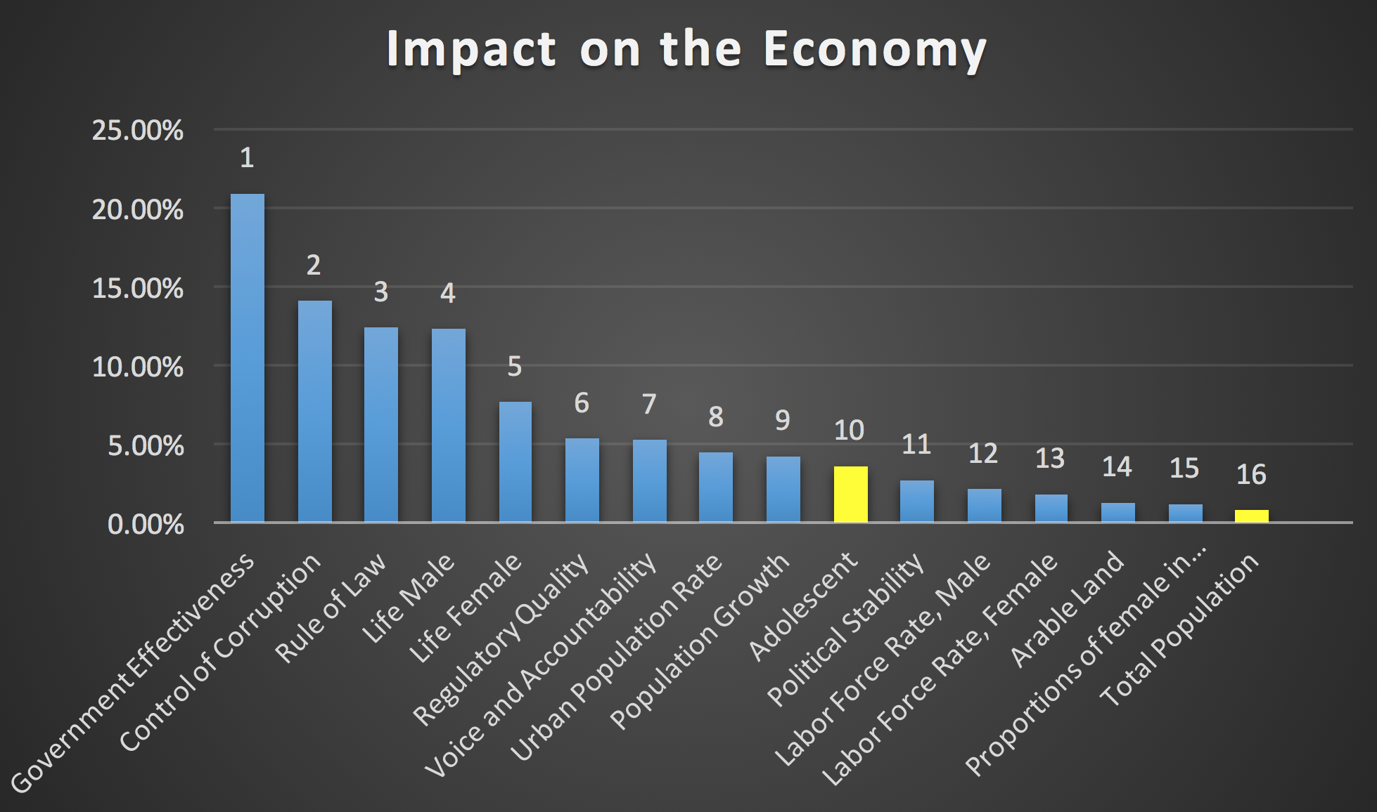
Model result – importance of each factor

Slide 11
12 countries selected
Australia
Brazil
China
Egypt, Arab Rep.
Ethiopia
Germany
India
Japan
Nigeria
Russian Federation
Sweden
United States

Slide 12

Why we select them?
Area
Total GDP
Population
39%
60%
54%

Slide 13
Visualization
The three most important subjective governance factors:
Government Effectiveness
Control of Corruption
Rule of Law
The three most important objective statistical factors:
Life expectancy at birth, male (years)
Life expectancy at birth, female (years)
Urban population (% of total)
GDP per capita V.S.
GDP per capita V.S.

Slide 14
Prediction:
Based on the data in the past 34 years (1981 ~ 2014)
Predict the total GDP and GDP per capita of the 12 countries in the future until the year of 2025
Time series analysis using ARIMA (0, 2, 2) model

Slide 15
Conclusion
Overall, governance factors have greater impact than objective statistical factors on a country’s economy
Population growth has positive impact on GDP; while total population has negative impact on GDP
XGBoost and Random Forest have the best fit on the data

